Slide 1

Action-Oriented Query Processing for Pervasive Computing
Qiong Luo
Joint work with Wenwei Xue
Hong Kong University of Science and Technology
(HKUST)

Slide 2
Overview
Goal
  To help pervasive computing app. development
Hurdles
  Networked, heterogeneous devices
  Device operations in addition to data flows
Our approach
  Allowing action-embedded queries on devices
  Performing action-oriented query optimization
Query processors as part of pervasive computing platform
Notes:
Not addressing all pervasive computing applications, but a subset of them; typically monitoring applications.
Not full query processors, but partial, specialized query processors.

Slide 3
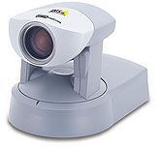
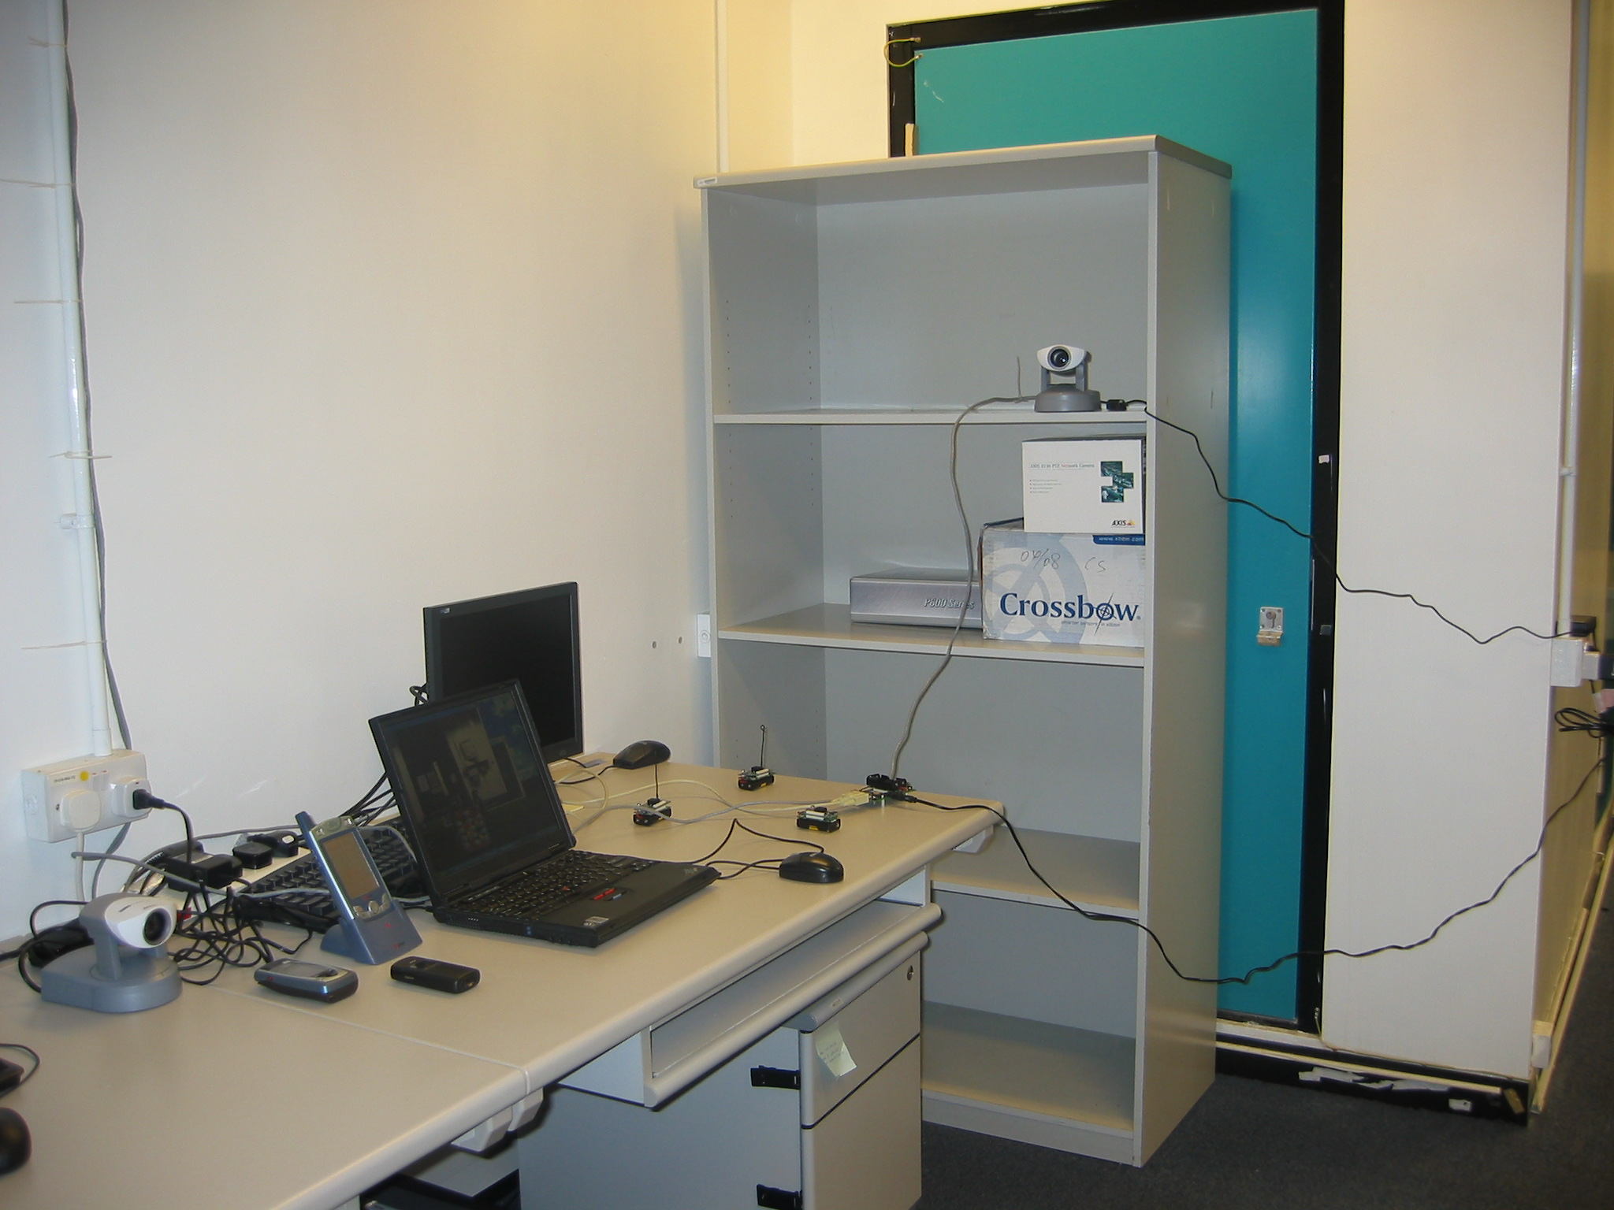
Pervasive Computing Environments
Handheld Devices
Network camera
Berkeley Motes
Laptops
Pervasive computing devices communicate and take actions.

Slide 4
A Problem in Pervasive Computing
Hard to develop & optimize applications
  Heterogeneous devices
  Heterogeneous networks
  Actions (operations) as well as data involved
  Limited Application Programming Interfaces
  Frequent upgrades
  …

Slide 5
Database Query Processing
SQL (SELECT-FROM-WHERE…)
  Relational tables + objects (text, image)
  Views, triggers, user-defined functions
Cost-based optimization
  Relational operators (selection, projection, join)
  Second-class citizens (triggers, UDFs)
Fixed or adaptive query execution
How to apply it to pervasive computing?

Slide 6
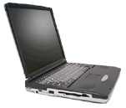
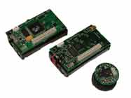
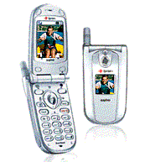


Our Solution: AORTA
Application1
Application2
Application3
Declarative Interface for Queries and Actions
AORTA
AORTA
Action-Oriented Query Execution Engine
Uniform Data Communication Layer
PCs
sensors
cameras
PDAs
cell phones

Slide 7
Outline
Introduction
Action-oriented query interface
Action-oriented query optimization
Experimental evaluation
Conclusion and future work

Slide 8
An Example of AORTA Query
CREATE AQ night_surveillance AS SELECT sendphoto (p.no, photo (c.ip, s.loc, “images/”)) FROM sensor s, camera c, phone p WHERE s.accel_x > 500 AND coverage (s.loc, c.loc) AND p.owner = “admin” START atTime (0, 0, 0) STOP atTime (5, 0, 0)
An AORTA query may involve physical actions.

Slide 9

Query Plan of night_surveillance
sendphoto(p.no, “images/”)
photo(c.ip, s.loc, “images/”)
coverage (s.loc, c.loc)
s.accel_x > 500
p.owner = “admin”
Sensors
Cameras
Phones
Actions are treated as query operators in AORTA.

Slide 10
Query Processing in AORTA
Description of actions
Estimation of action cost
Selection of multiple devices for one action
Group optimization of multiple actions

Slide 11
Action Profile of photo()
<actionProfile>
<name>photo </>
<params>
<1>$camera_ip</><2>$location</>
<3>$directory_name</>
</params>
<returnType>image</>
<device>
<type>camera</>
<model>AXIS 2130(R) PTZ Network Camera</>
<physicalStatusInvolved>
<attribute><name>pan</><value>$pan</></attribute>
<attribute><name>tilt</><value>$tilt</></attribute>
<attribute><name>zoom</><value>$zoom</></attribute>
</physicalStatusInvolved> …

Slide 12
Action Composition of photo()
…
<operationSequence>
<operation>
<atomicOperation>connect</>
<number>1</>
</operation>
<operationSet>
<operation>
<atomicOperation>pan</>
<number>deltaPan($pan, $location)</>
…
The action composition is specified in the action profile.

Slide 13
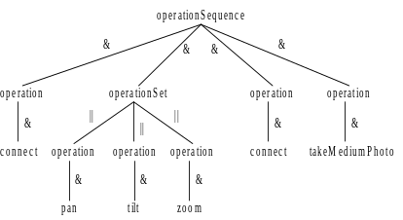
Composition Tree of photo()
“&”: sequential execution
“||”: parallel execution

Slide 14
Grammar of Action Composition
action := operationSequence
operationSequence := operationUnit (& operationUnit)*
operationUnit := operationSequence | operationSet | operation
operationSet := operationUnit (|| operationUnit)*
operation := atomicOperation (& atomicOperation)*
Note: The atomicOperations of an operation must be identical.

Slide 15
Components of Action Cost Model
A set of atomic operations
A grammar of action composition
The profile of the action
Estimated costs of atomic operations
The cost formulas

Slide 16
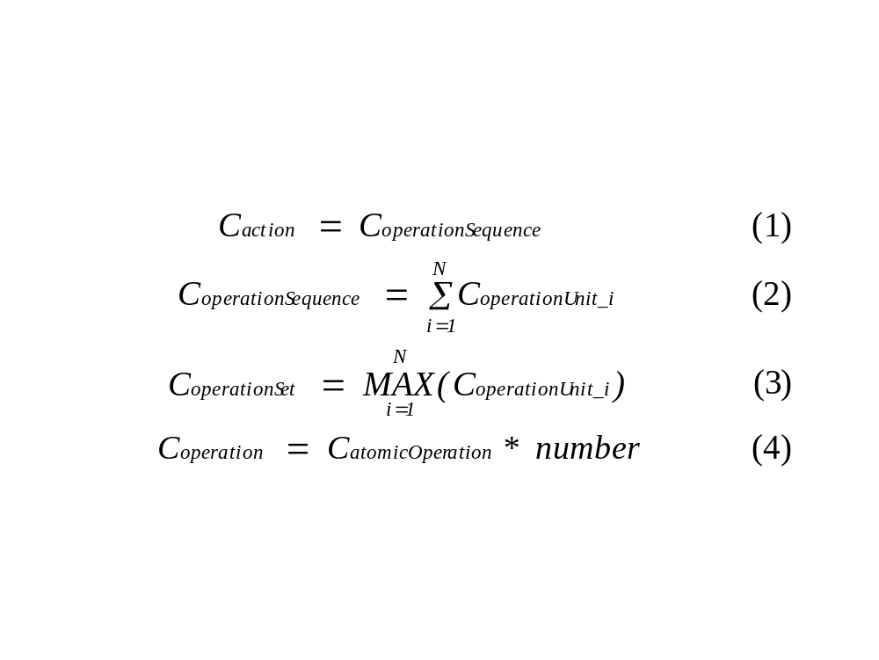
Cost Formulas for Actions
We use response time as cost metric; other metrics may differ.

Slide 17
Action Cost and Device Status
changes
Action Execution
Device
Physical Status
affects the cost
Example: photo() on PTZ network cameras
  Physical status
    Head position (pan, tilt, zoom values)
    Workload (affects the cost of connect())

Slide 18
Optimization of a Single Action
Poll candidate devices in parallel
  Check the availability of the devices
  Examine their current physical status
  Set a TIMEOUT value for unresponsive devices
Estimate the execution cost of each device
Select the device of the least estimated cost
App. semantics: unnecessary to operate all candidate devices

Slide 19
Group Optimization of Actions
Goal: load balancing among devices
Task: assigning multiple actions to devices
The original problem is NP-hard.
Our own greedy algorithm:
  (1) assign each request to a device of least cost
  (2) on each device, order and execute requests

Slide 20
Experimental Setup
A Pentium III PC running XP
  750MHZ CPU, 512MB memory
Networked devices
  Ten Crossbow MICA2 motes
    Scattered in the pervasive lab
  Four AXIS 2130 PTZ network cameras
    Two mounted on the ceiling
    Two placed on the desks

Slide 21
Validation of the Cost Model
Query: snapshot (take a photo of a location)
Target location: Mote 1 (on the front door)
All four cameras were candidate devices
  All starting from the home position
    (pan = 0, tilt = 0, zoom = 1)
Camera 3 was malfunctioning
Camera ID | 1 | 2 | 3 | 4
Estimated Cost* | 2993 | 3638 | N/A | 3347
Real Cost* | 3061 | 3682 | N/A | 3381
*units: milliseconds

Slide 22
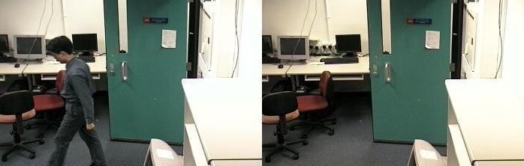
Optimization of a Single AQ
  Left: 2.6 seconds, Right: 3.2 seconds
Small difference in response time, large difference in result.

Slide 23
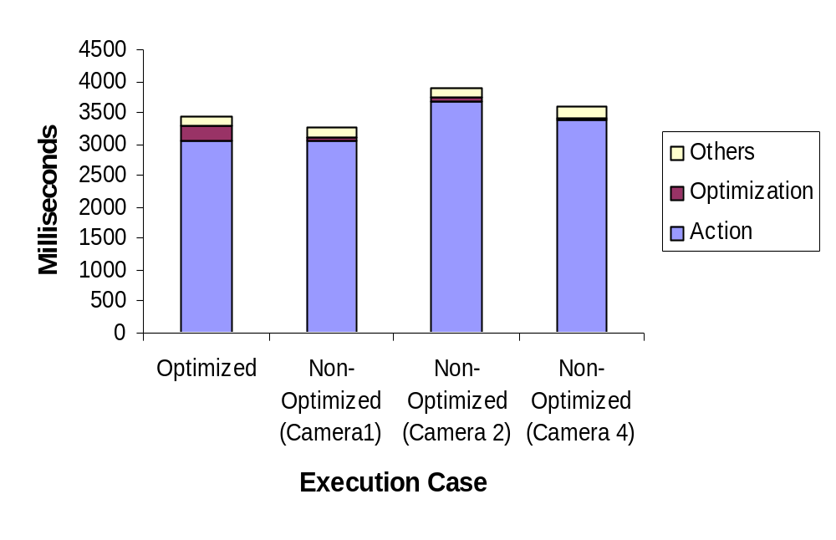
Time Breakdown
Optimization has a low overhead and balances workload.
Notes:
Action: usually > 3 seconds
Optimization: tiny in comparison
Optimization case: 220 seconds
70 seconds only if Camera 3 is excluded
Non-optimized cases: 40 seconds
Others: negligible

Slide 24
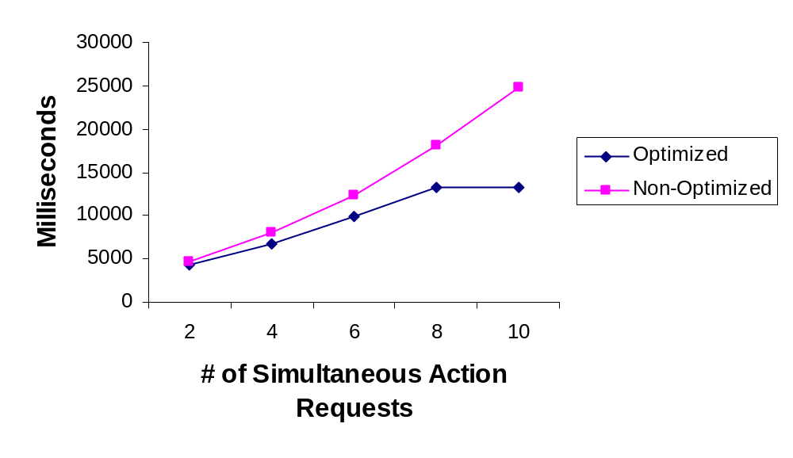
Effect of Group Optimization

Slide 25
Related Work
Pervasive computing
  Homogeneous network, non-DB perspective
Parallel computing: general job scheduling
Database triggers, UDFs, stored procedures
Sensor databases, data stream systems
Group optimization
Adaptive query processing

Slide 26
Conclusion and Future Work
Aorta
  Extends SQL for action-embedded queries
  Performs action-oriented query processing
  Helps application development & optimization
Future work
  Generalization of actions as classes of UDFs
  New types of actions, multi-device actions
  Other group optimization techniques
Comments are welcome: http://www.cs.ust.hk/~luo

